Slide 1


D-Mart Sales Data Analysis Project
This project focuses on analyzing retail sales data from D-Mart to uncover actionable business insights using Python, SQL, and Power BI. It demonstrates end-to-end data analysis and business insight generation suitable for Data Analyst roles.

Slide 2

Project Overview: Unlocking Retail Potential
Data-Driven Insights
Technology Stack
Utilizing Python, SQL, and Power BI for comprehensive analysis.
Leveraging D-Mart's sales data to drive strategic business decisions.
Actionable Outcomes
Translating raw data into clear, implementable business strategies.

Slide 3

The Business Problem: Navigating Low Margins
Retail businesses operate on low margins and high volume, making efficient data utilization critical. The core challenge lies in converting vast amounts of raw sales data into meaningful insights that can inform strategic decisions.
Without proper analysis, businesses risk missing opportunities to optimize sales performance, understand customer behavior, and maximize profitability.

Slide 4
Key Objectives of the Analysis
1
Identify Top-Performing Products & Categories
2
Analyze Sales & Profit Trends
Understanding patterns over time to forecast demand and manage resources effectively.
Pinpointing what sells best to optimize inventory and marketing efforts.
3
Evaluate Regional/Store Performance
4
Support Inventory & Pricing Decisions
Assessing individual store and regional contributions to identify areas for improvement or replication.
Providing data-backed recommendations for stock levels and pricing strategies.

Slide 5

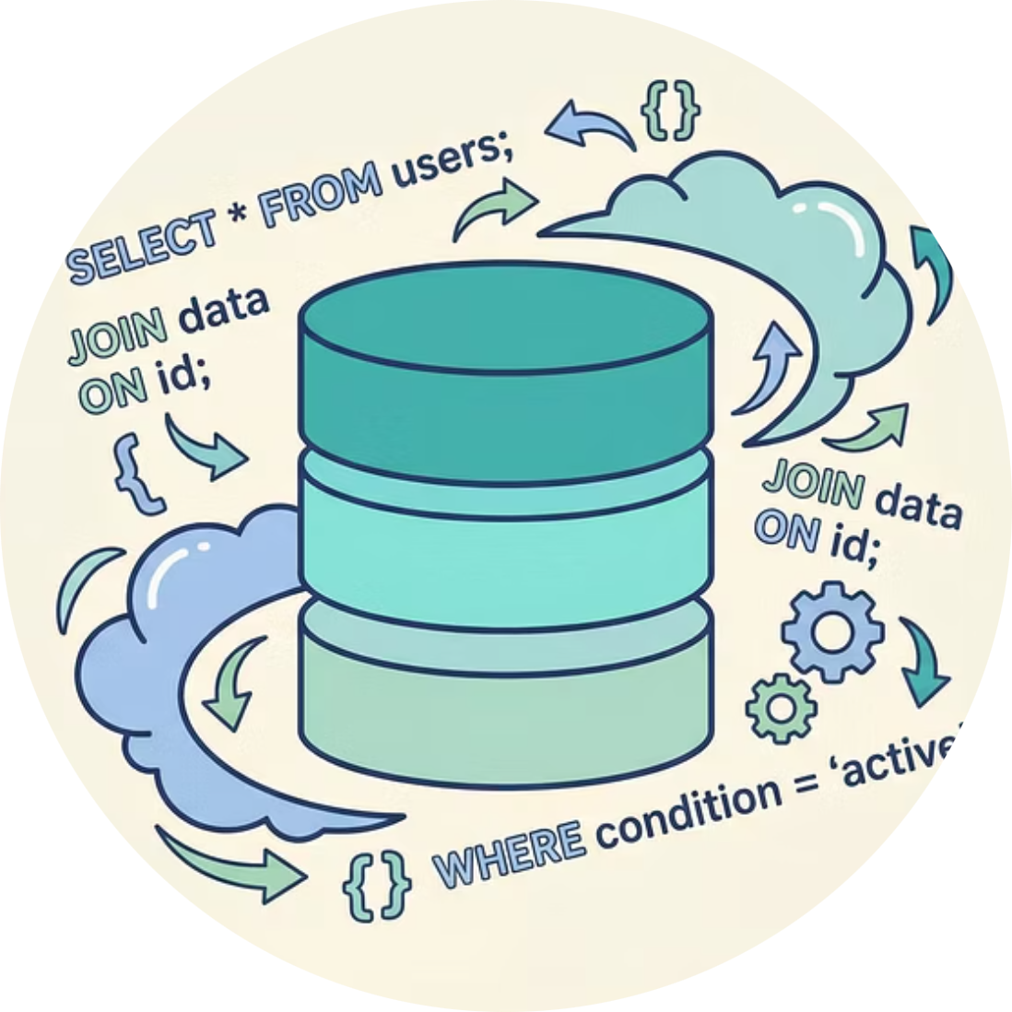

Tools of the Trade
Python
SQL
Power BI
Utilized for data manipulation and analysis with libraries like Pandas, NumPy, and Matplotlib.
Employed for efficient data extraction, querying, and management from D-Mart's databases.
Used for creating interactive dashboards and visualizations to present insights clearly.

Slide 6
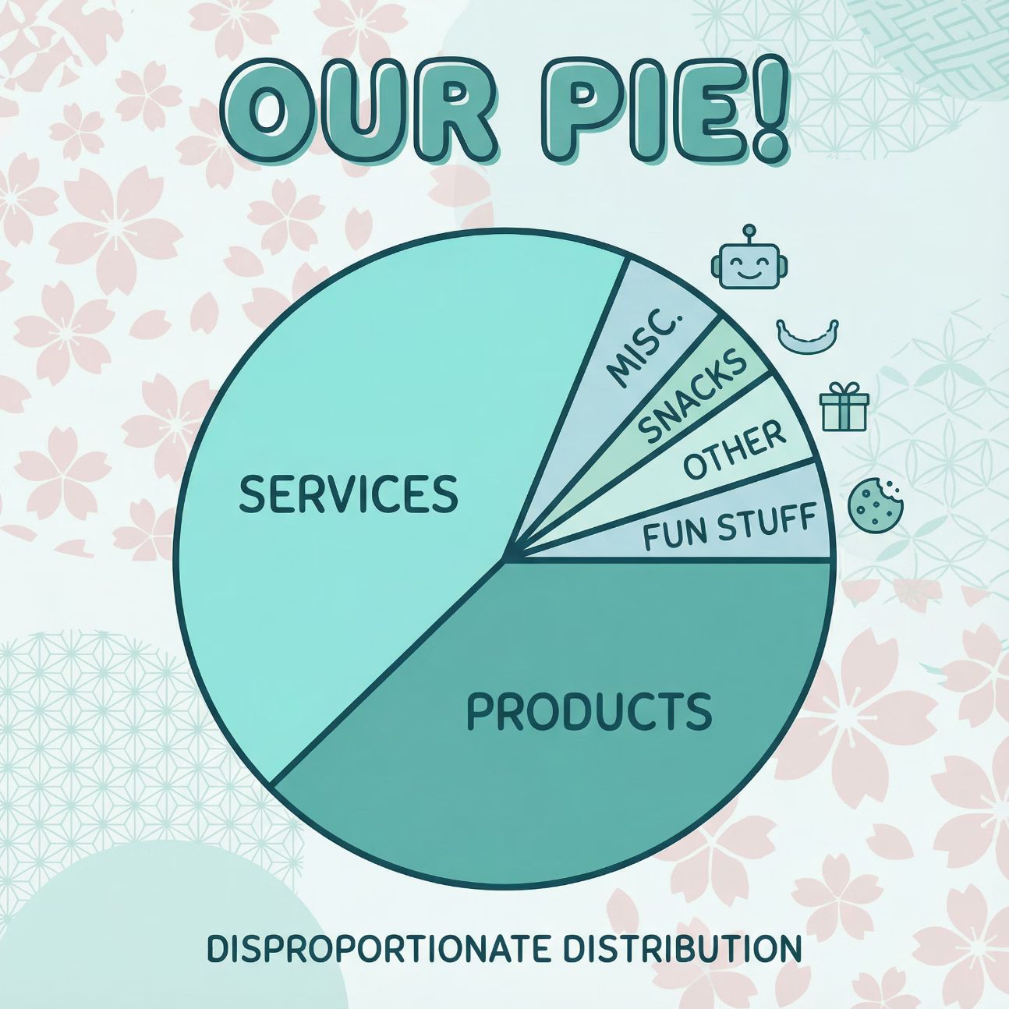
Key Insight 1: Revenue Concentration
Our analysis revealed that a significant portion of D-Mart's revenue is generated by a surprisingly small number of product categories. This concentration highlights the importance of these key categories for overall business success.
Understanding which categories are the primary revenue drivers allows for targeted strategies in inventory management, marketing, and promotional activities to maximize their potential.

Slide 7
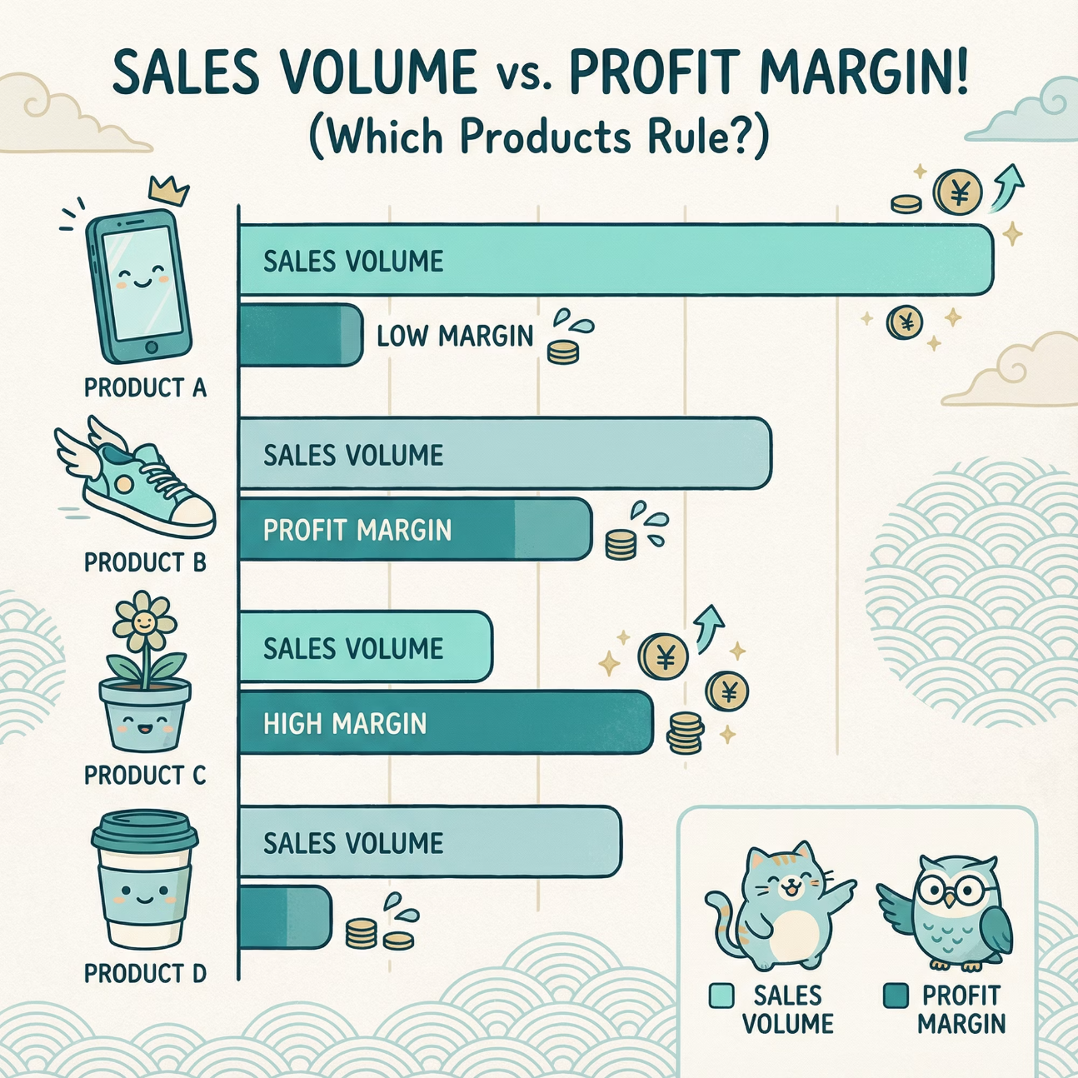
Key Insight 2: Sales vs. Profit Discrepancy
A critical finding was the disparity between high-sales products and their actual profitability. Some products that move quickly contribute minimally to the bottom line due to low margins or high operational costs.
This insight is crucial for optimizing product portfolios and pricing strategies, ensuring that sales volume translates into healthy profit margins.

Slide 8

Key Insight 3: Seasonal Trends
The data clearly indicated distinct seasonal trends in sales across various product categories. These predictable fluctuations are vital for proactive inventory planning, staffing adjustments, and targeted seasonal promotions.
By anticipating these trends, D-Mart can optimize stock levels, reduce waste, and capitalize on peak demand periods, leading to increased efficiency and profitability.

Slide 9


Key Insight 4: Regional Performance Variation
Performance varied significantly across different regions and individual stores. Factors such as local demographics, competition, and operational efficiency contributed to these disparities.
Identifying top-performing regions and understanding their success factors can inform best practices that can be replicated elsewhere, while underperforming areas can receive targeted support and strategic interventions.

Slide 10

Conclusion: Empowering Data-Driven Retail
Strategic Decision Making
Enhanced Profitability
Future-Proofing Retail
Optimizing operations based on data leads to improved margins.
A robust data analysis framework for continuous growth and adaptation.
Insights enable better inventory, pricing, and marketing choices.

